Slide 1
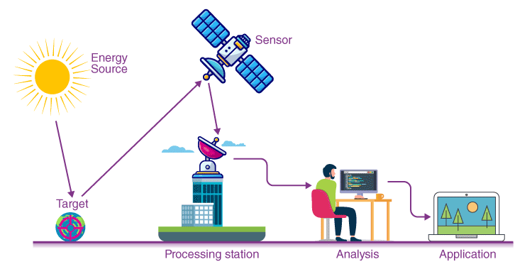


RESEARCH

Slide 2
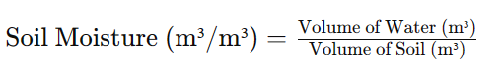
UNIT LIS OUTPUTS
Preprocessed Monthly LIS outputs (P_LIS)
PPT, Qs, Qsb
(kg/m^2/s)
kg/m2 = 1mm (water=1000kg/m3)
Soil Moisture (m3/m3)
LIS output are in kg/m^2/s. It is a daily average. Qw multiply it with *60*60*24 = mm/day.
We sum up this daily average over all days in each month to get monthly average (mm/month).
We shouldn’t treat soil moisture as other variable since unit are different.
LIS_Merra2
LIS_IMD LIS_IMDc
LIS_CHIRPS LIS_ERA5

Slide 3
Preprocessed Monthly LIS outputs (P_LIS)
Data conversion : The LIS output is daily data saved in yearly folder. We merged all the output in HPC since it requires a lot of time and memory
Data synthesis
Data scanning : Investigated the flaws or discreprencies in RE data
Final code : Sorting all the data inconsisties and producing preprocessed outputs
LIS_Merra2
LIS_IMD LIS_IMDc
LIS_CHIRPS LIS_ERA5
1-Data processing
2_Preliminary checks
LIS outputs
RE gamma or norma
Validated LIS IMD and LIS IMDc
RE_reg
PQ curve
3_REanalysis
4_RE_trnd
LIS output are in kg/m^2/s. It is a daily average. We Average this daily average over all days in each month to get monthly average. Finally we have the monthly data of each LIS forcing. LIS*60*60*24*30 = mm/month
RE_mean_var
RE_P correlation
PQ curve
4_RE_Teleconnection
5_Physiographic aspect
soil
LULC
Antecedent condition

Slide 4
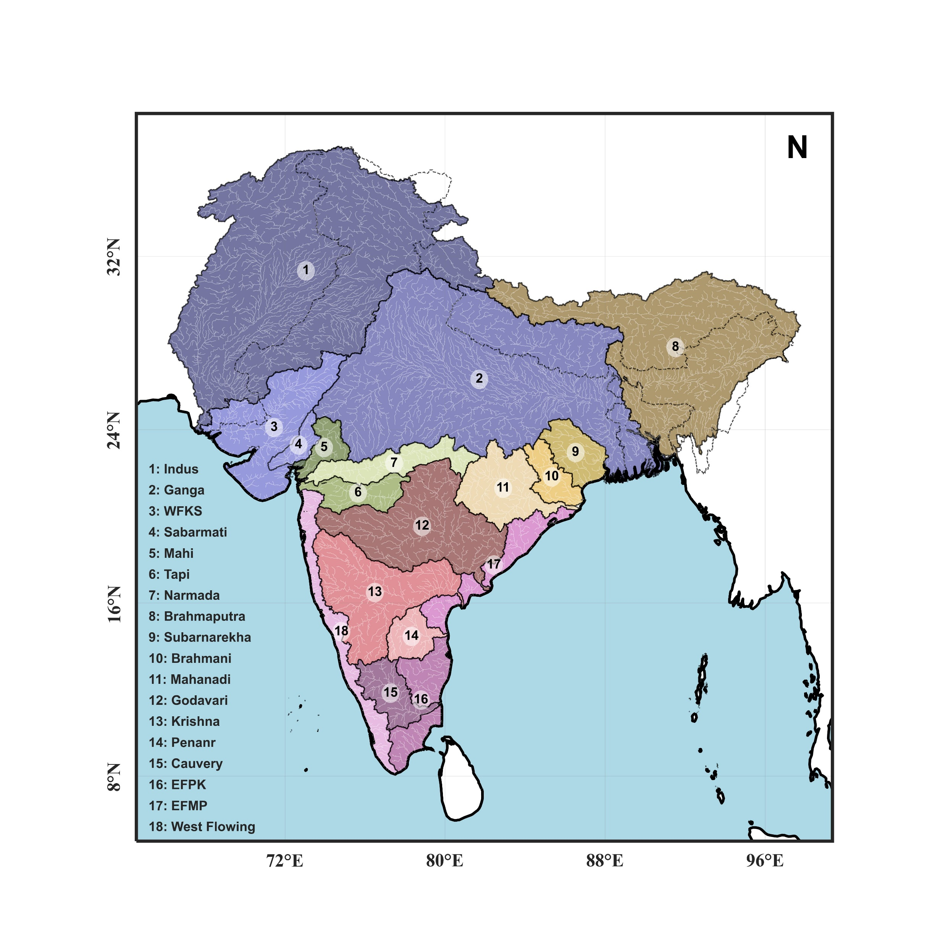

Slide 5
0_Preprocessing
0_LISOUTPUT
1_DATASCANNING
2_FINAL PREPROCESSED OUTPUT
Converting the LIS output to Monthly
Scannning flaws and discrepancies in data
Generate all the inputs for the analysis after solving all the data inconsistencies

Slide 6
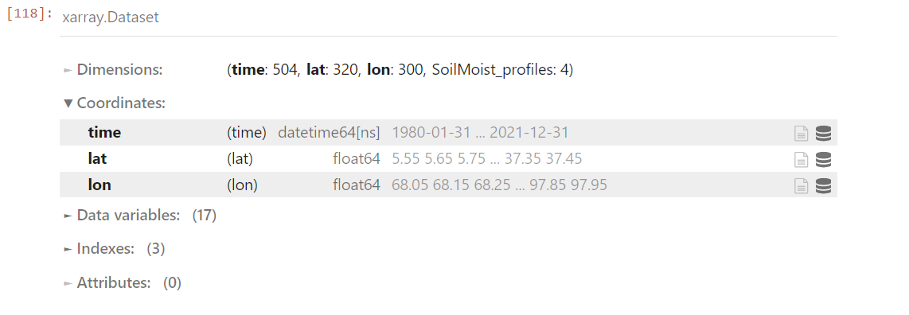
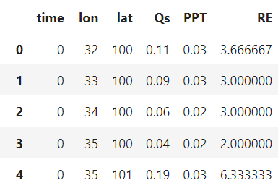
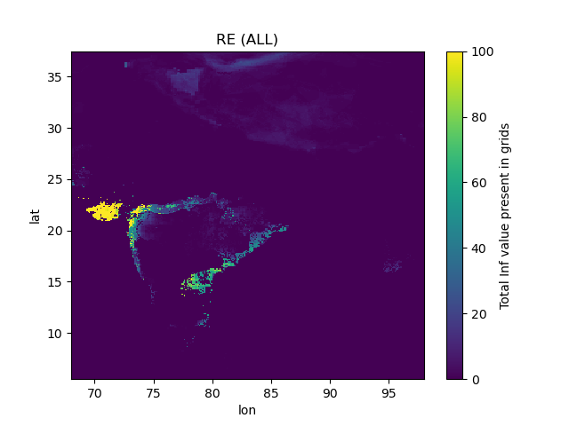
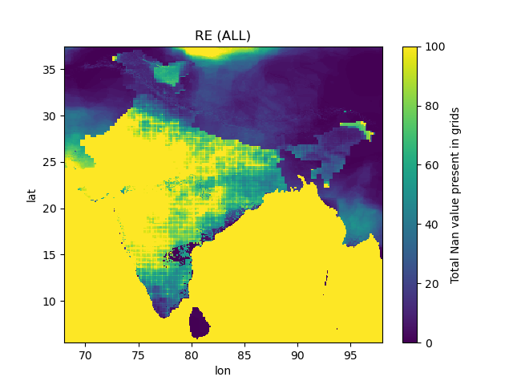
0_preprocessing (Data scanning)
One way to deal is convert all to 0. But this wouldn’t be good. Because an RE of 0 value has meaning.
For eg: if there is zero rainfall and Qs at a particular time deosn’t means RE is zero at that time. RE is a potentiality of catchment.
1. nans:: There are a lot of nan and inf values present in RE.
Nans occurs when both qs and ppt are 0.
Mean/Var : Nan wont effect
Trend analysis: it automatically avoid nans so no need of changing
Correlation : Nan/ inf to be replaced.
Fitting dist : nan should be removed
2. Inf : Inf values present in RE.
Inf occurs when ppt is zero while qs is near zero (0.01). Such a situation shouldn’t occur in the real sense
3. Anomolous RE (>1): There are many locations where anomalous RE conditions are there.
Qs > ppt at that location. These are all identified in near-zero rainfall condition
Due to residuals
Solution
Make all these to nan itself.
Then calculate RE.
Nan value wont take part in any calculation

Slide 7
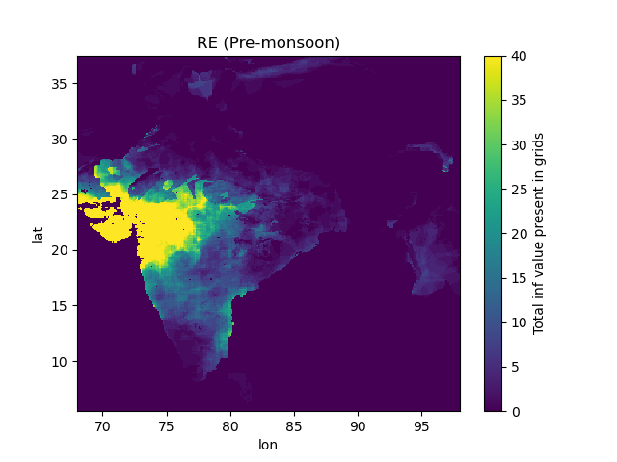
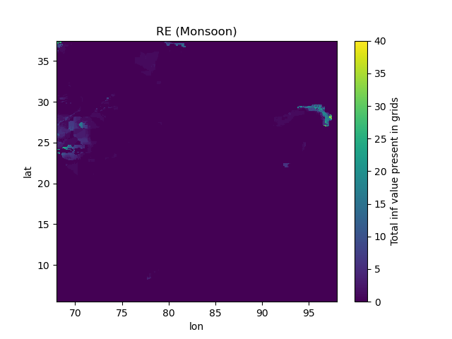
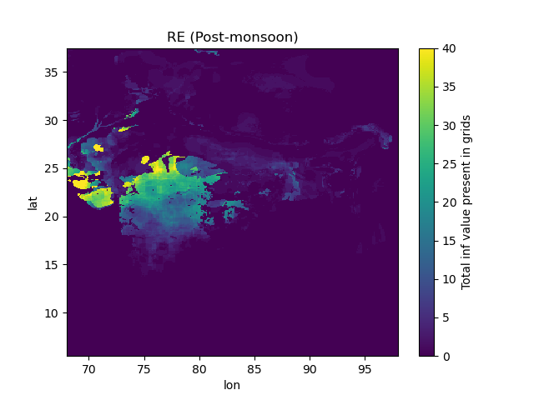
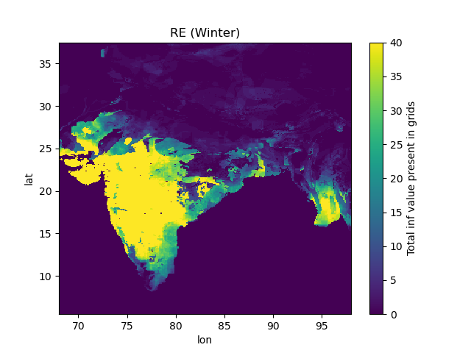
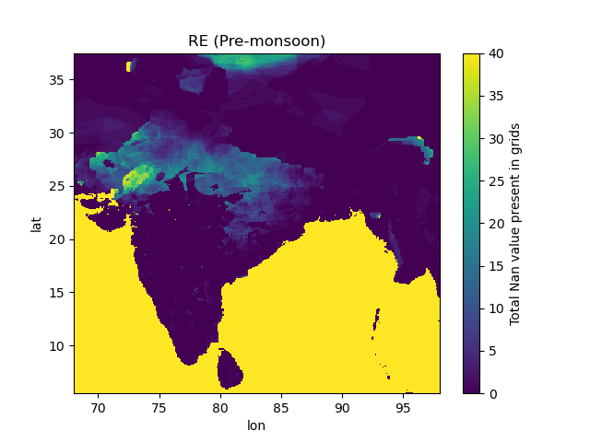
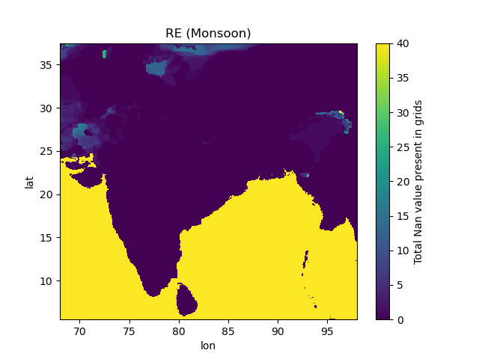
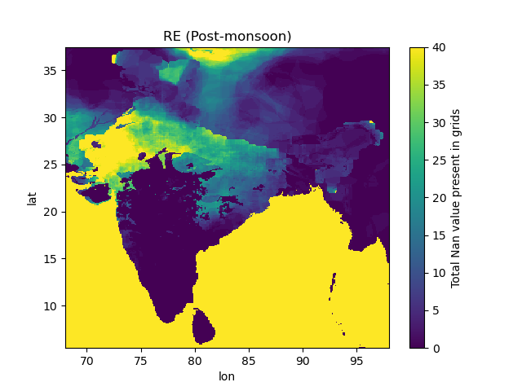
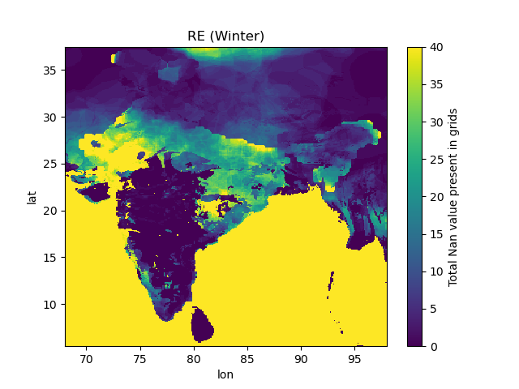
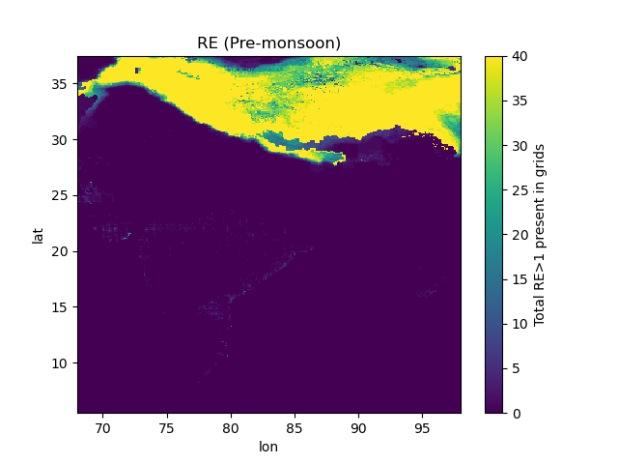
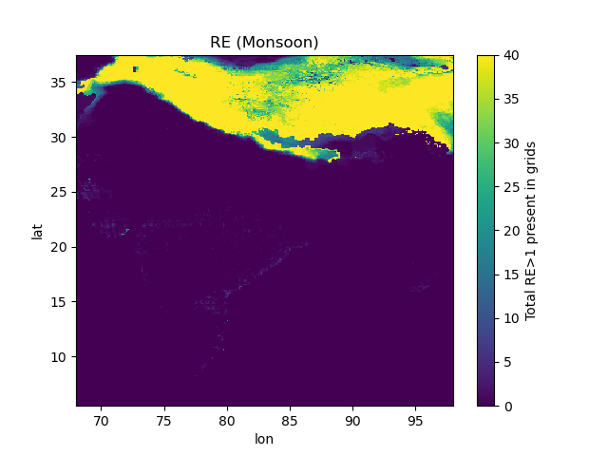


0_preprocessing (Data scanning)
Inf
QS > 0
PPT=0
Nan
QS = 0
PPT=0
RE>1
QS > ppt
ppt>0

Slide 8
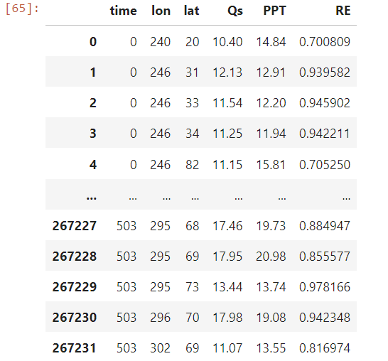
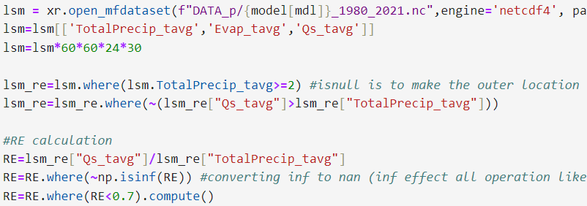
0_preprocessing (data scanning)
Another descepency : RE>0.8. A lot of grids showing very high RE.
Replace all ppt value < 2cm/ month. (since this near zero values causing a lot troubles, 0.001/0.001)
RE at these range won’t give the potential catchment charactestics
Set all points where Qs>ppt to nan
Final Solution
Calculate RE
Step 1 : Replace all inf to nan
Step 2 : Also remove RE>0.8
Without Nan
With Nan
Fill nan with linear interpolation (lon and time wise)
Mean/ Variance
Trend analysis
Fill nan with seasonal mean of timeseries ( to convert all nans at the data end)
Filling with mean is not good. Bcoz nan are mainly found in winter, But while calculating mean, the data of summer will also there
Teleconnection analysis : lon/lat interp is good
Trend analysis : time interpolation is good
Distribution Fitting
Correlation

Slide 9
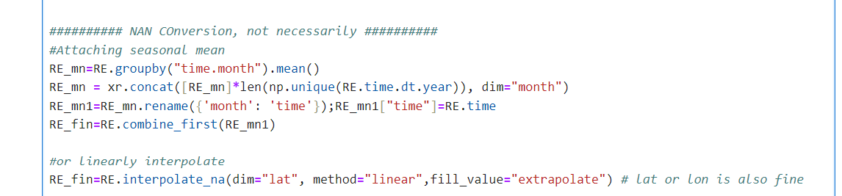
Placing monthly mean
Linear interpolation in time, lot and lat direction

Slide 10
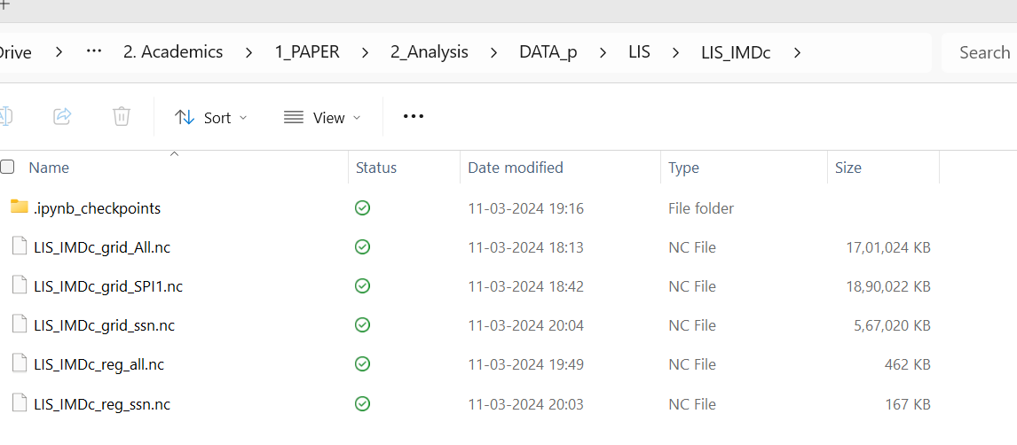
0_preprocessing (Final output)
All the preprocessed outputs are saved in data_p. The analysis is planned as grid wise and basin-wise. In each category, wee have the full time series, spi, and season
Note : In each .nc, we have RE (without removing nan) and RE_cleaned.
IMDc_grid_All
IMDc_grid_SPI1
We have the similar combination of outputs of all these case MERRA2, CHIRPS, ERA5, IMD, IMDc, IMDcnew
IMDc – IMD caliberated
IMDcnew – when we analysed it has been noticed that in indus region IMD caliberated give erroneous results. Ppt and Qs is very close and hence RE is near 1 always. So we extracted IMD output of indus region and placed on IMDc and created a newdataset, IMDcnew
Gridwise
IMDc_grid_ssn
IMDc_reg_All
IMDc_reg_SPI
Regional
IMDc_reg_ssn

Slide 11
1_PRILIMINARY ANALYSIS
0_Normalization
1_IMD vs IMD caliberated
2_REGRE vs REREG
In this one, we checked if gamma is necessary
Here we see why the indus region show higher RE in IMD caliberated while lesser in IMD LIS output
Evaluate the difference between region average with averages of RE over each region

Slide 12
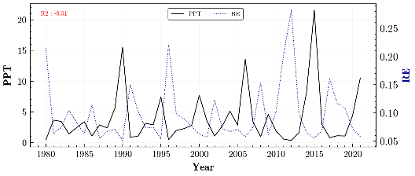
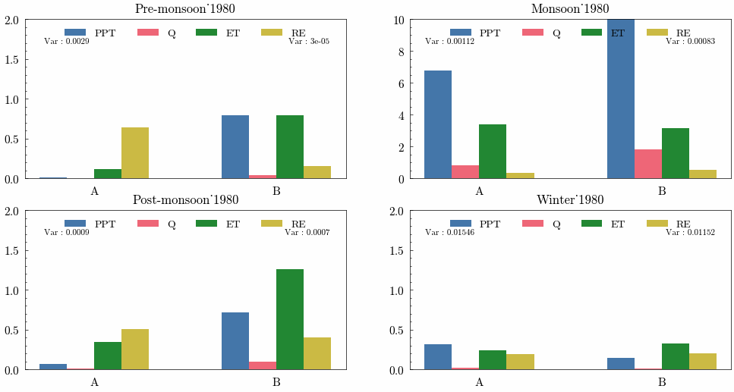
2_RE ANALYSIS
1_RE Mean_var
1_Mean_var
4_RE ANALYSIS
2_Result and discussion
2_Factors
3_PQcurve
4.2.1_Timeseries
Two regions have contrasting RE nature
4_Deep inves
4.2.1_GIF

Slide 13
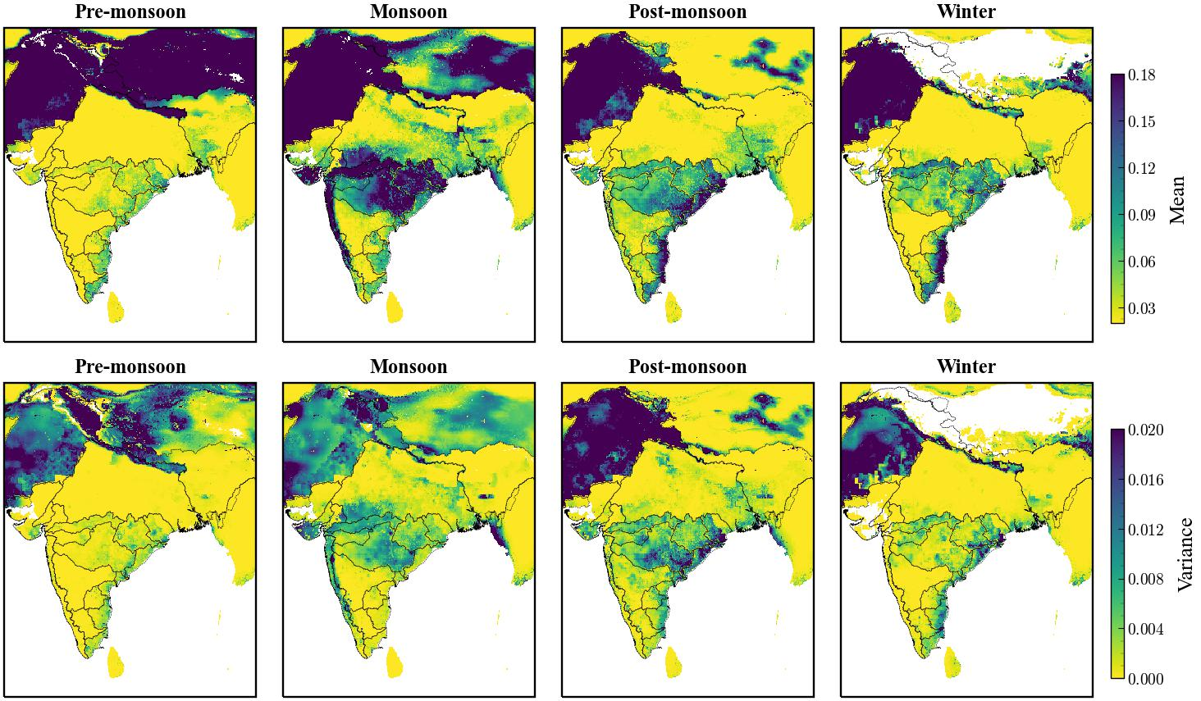
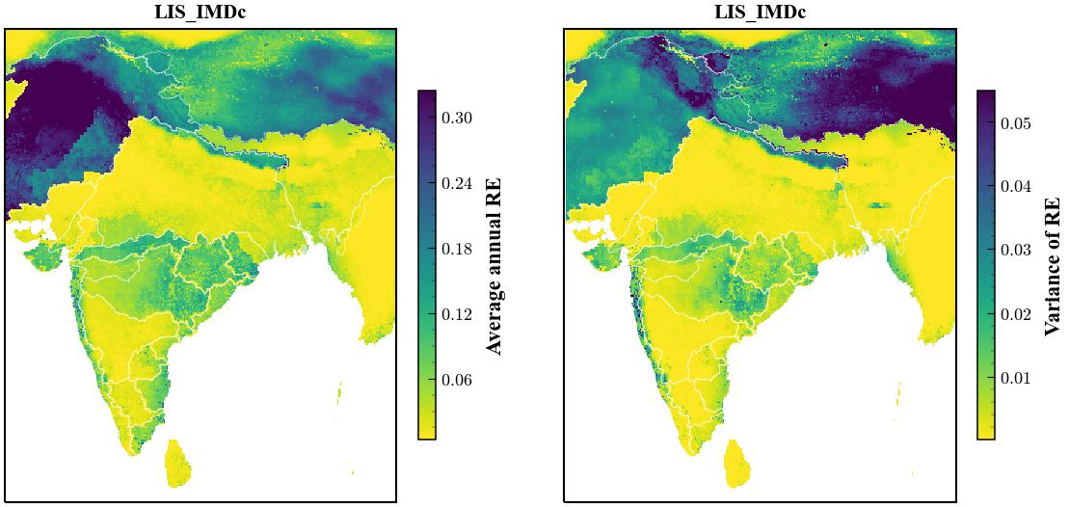
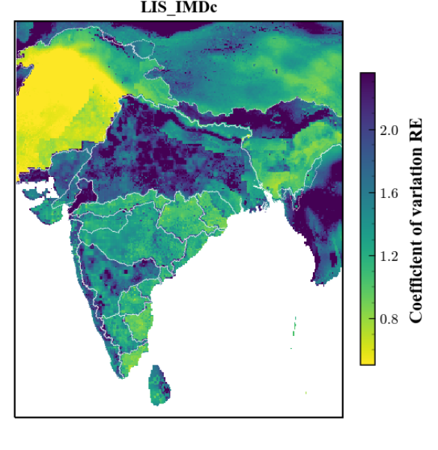
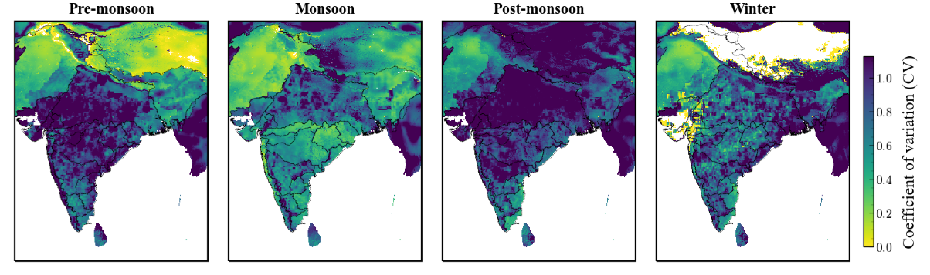
2_RE ANALYSIS
1_RE Mean_VAR
Variance is high wherever the mean is high. So we calculated CV for studying the RE variation. But CV also failed here since the data is normal. The plot just switches. The mean outweigh. Some other techniques should be tried
Solution
Median works better in these data. So it is good to calculate variance of data from median or some method (Standard Deviation to Median Ratio (SDMR))
Or z score normalization

Slide 14
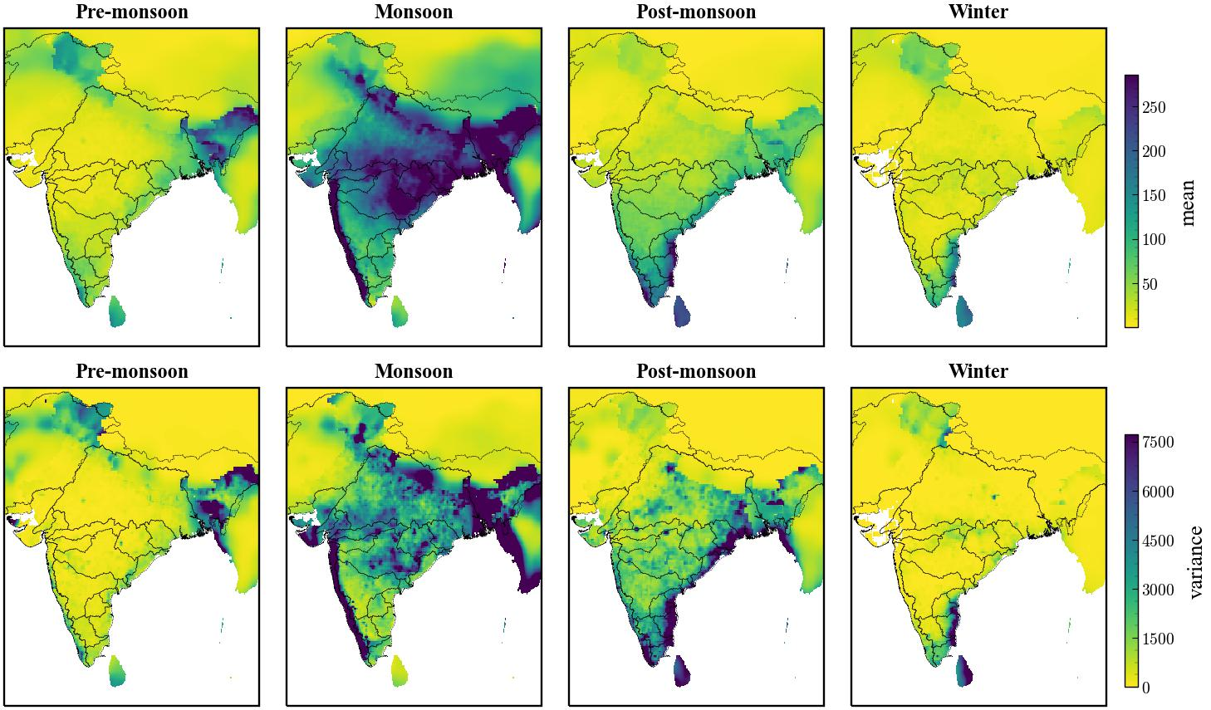
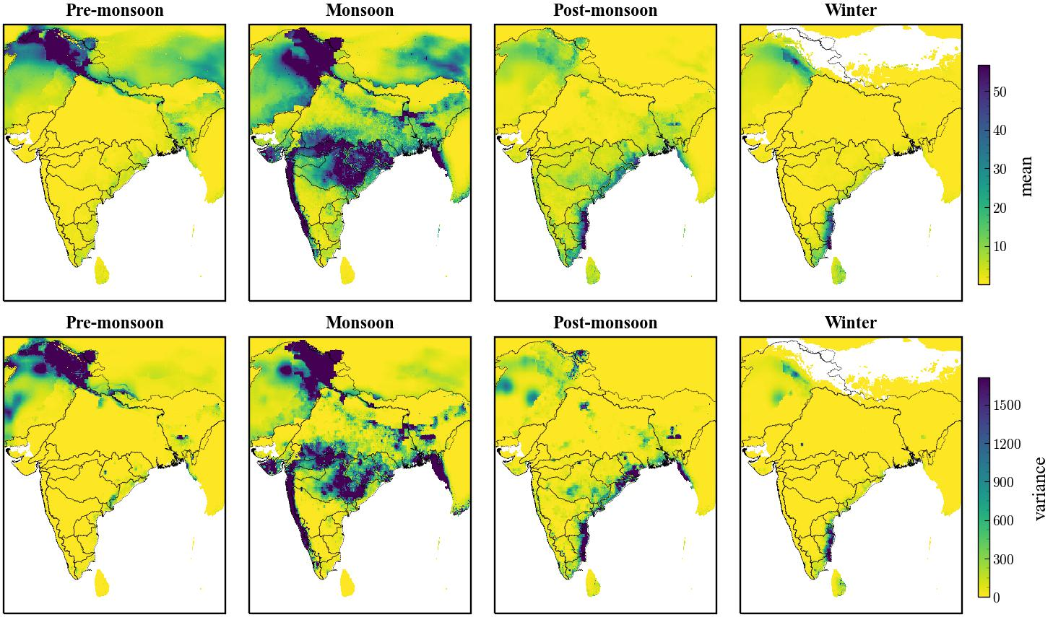
2_RE ANALYSIS
Continuation…
PPT
Runoff

Slide 15
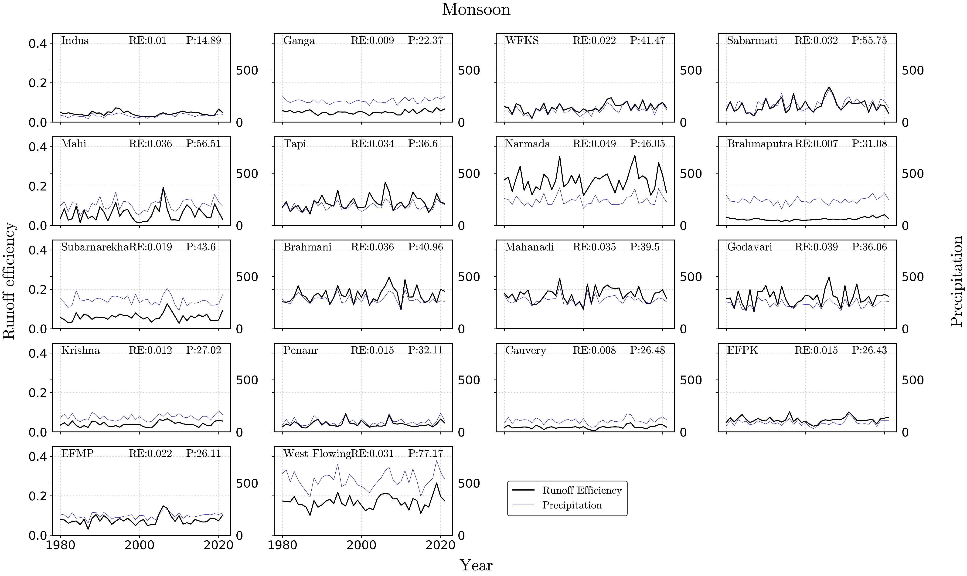
2_RE ANALYSIS

Slide 16
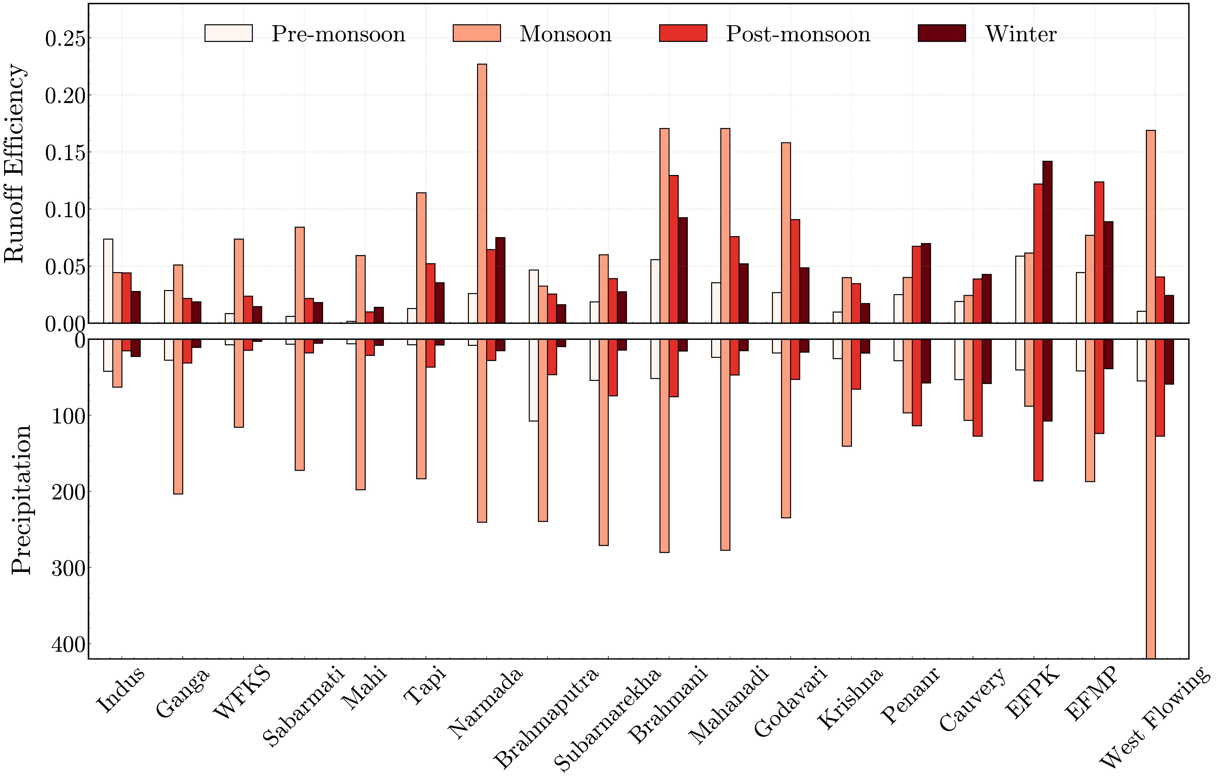
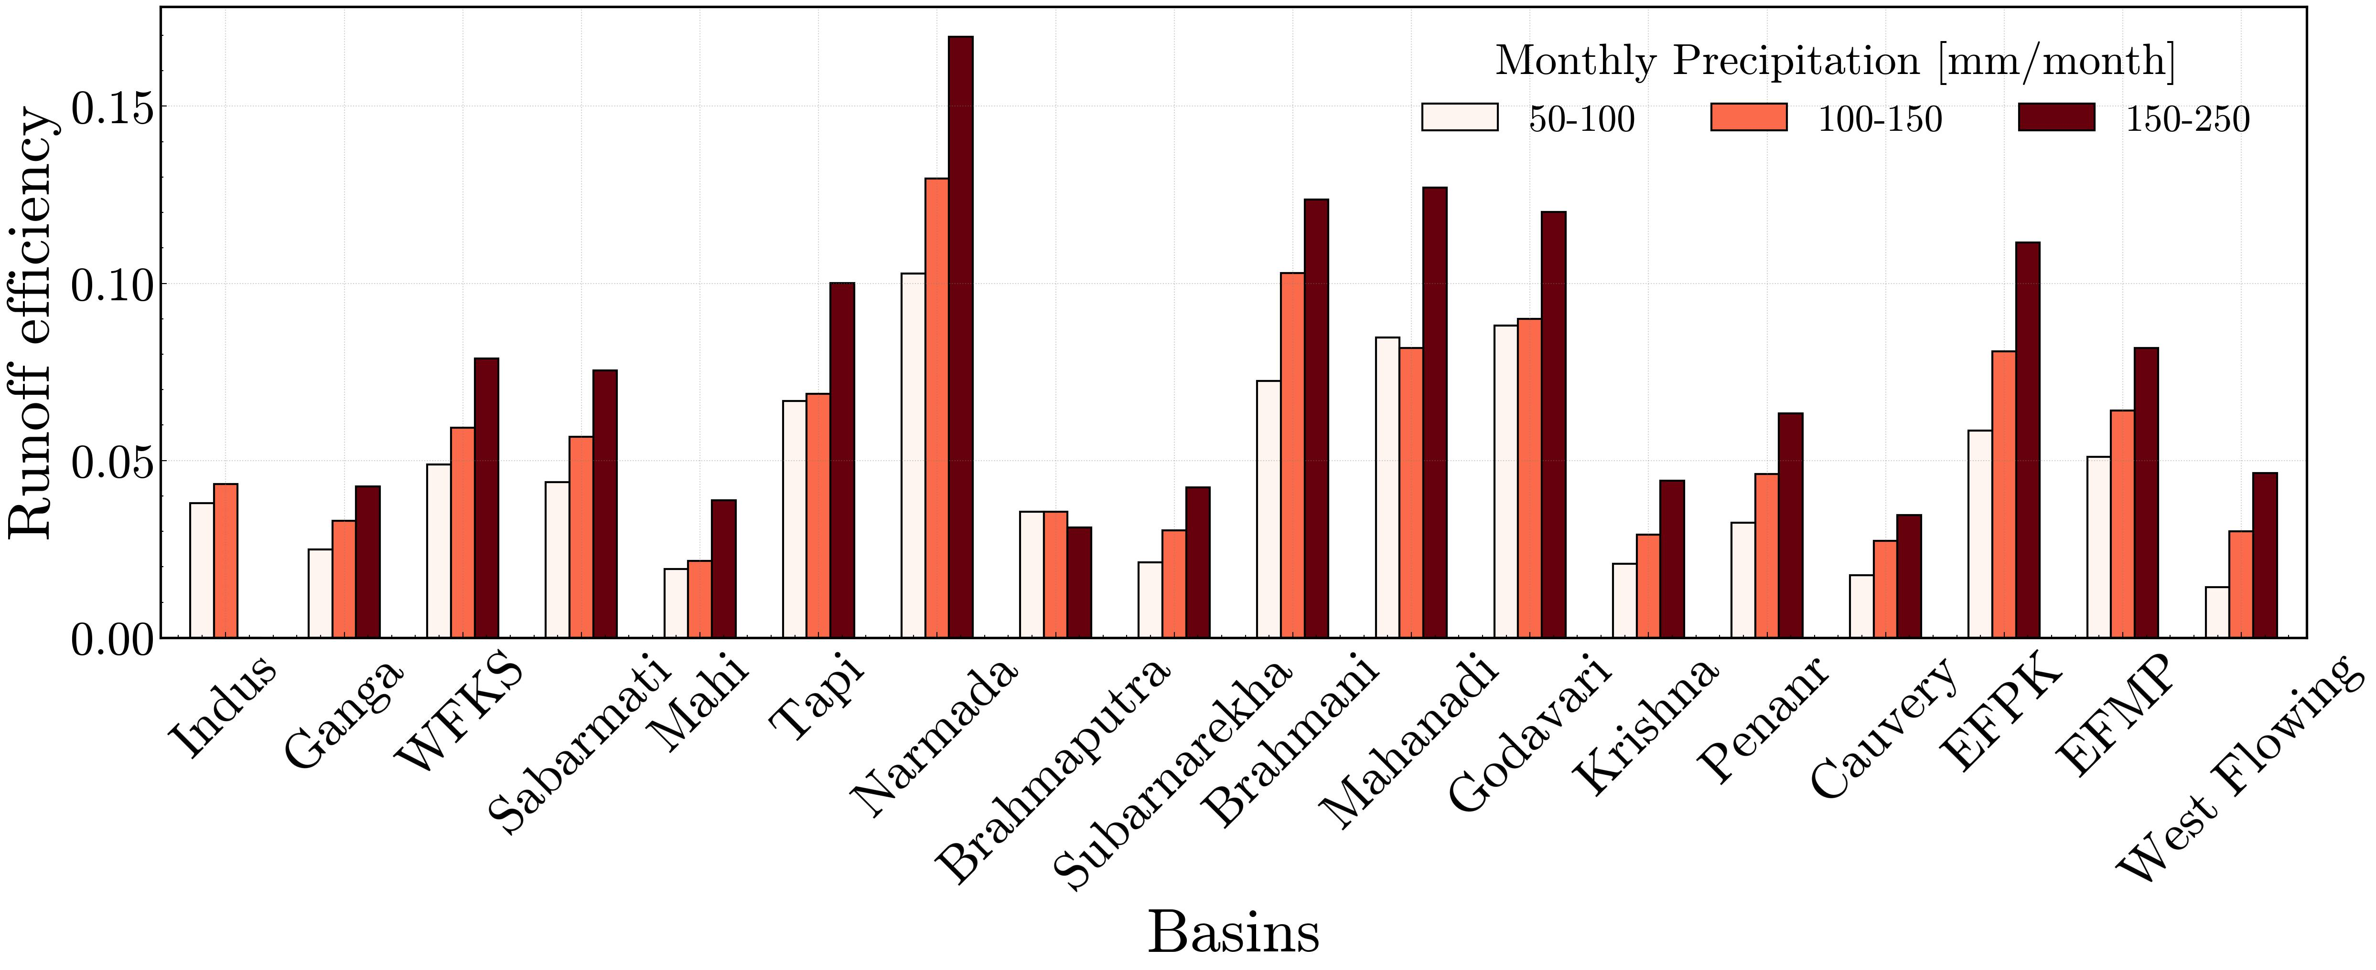
2_RE ANALYSIS
2_Result and discussion
This section is mainly to find out the values for explanation in R&D

Slide 17
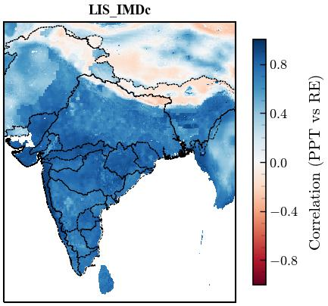
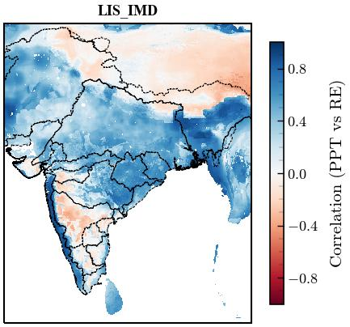
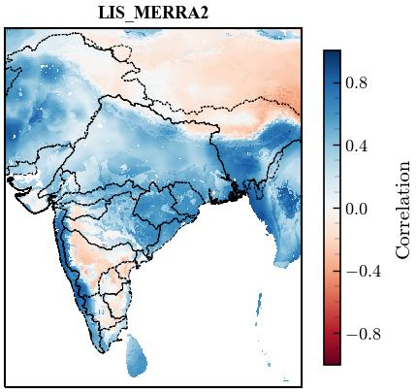
2_RE ANALYSIS
3_RE P Q correlation

Slide 18
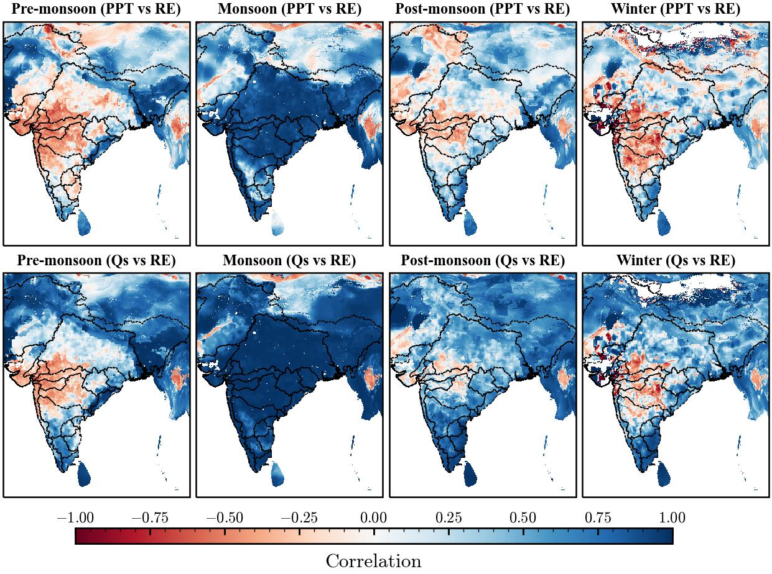
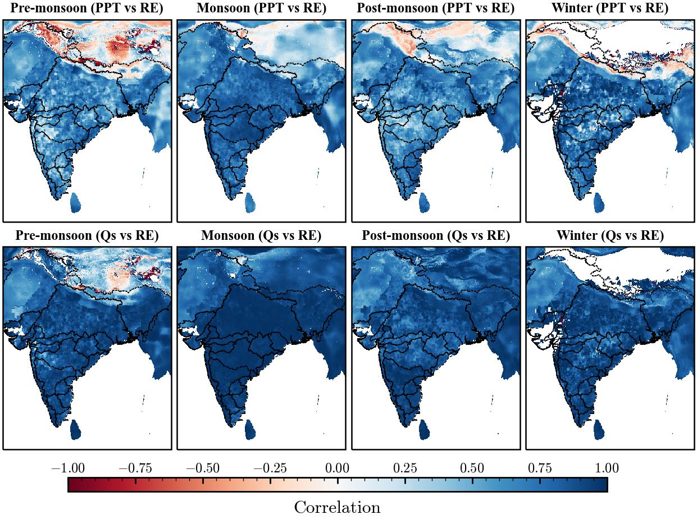
2_RE ANALYSIS
3_RE P Q correlation
IMD Caliberated

Slide 19
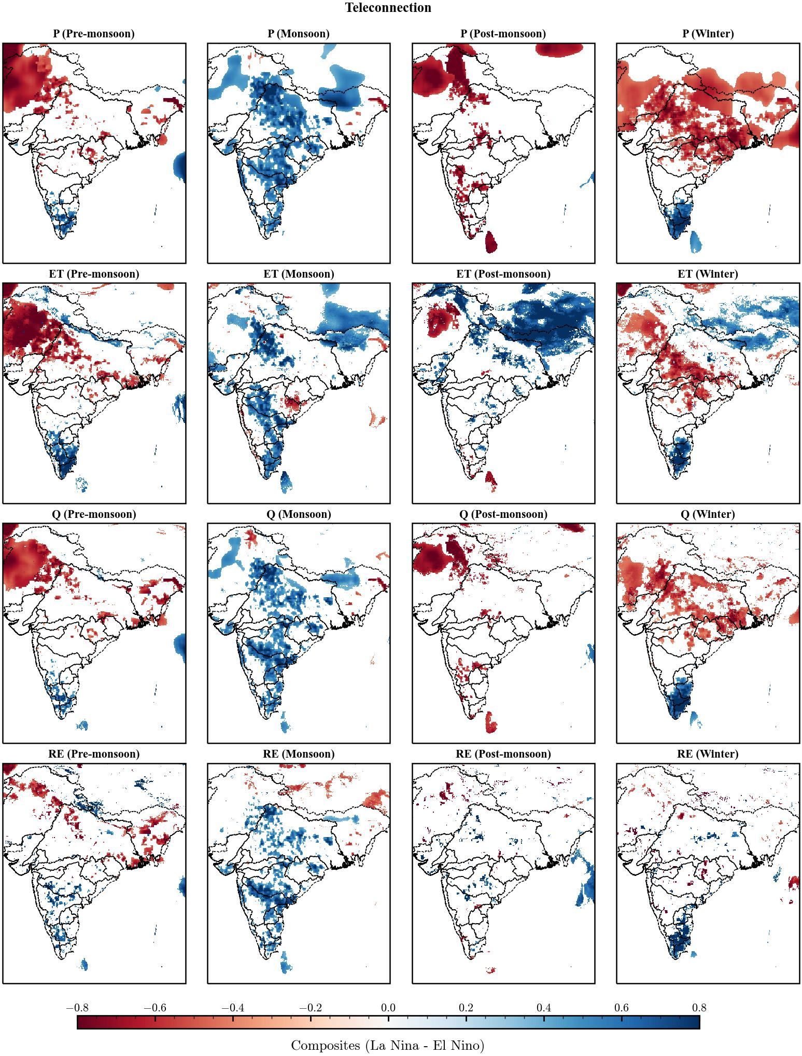
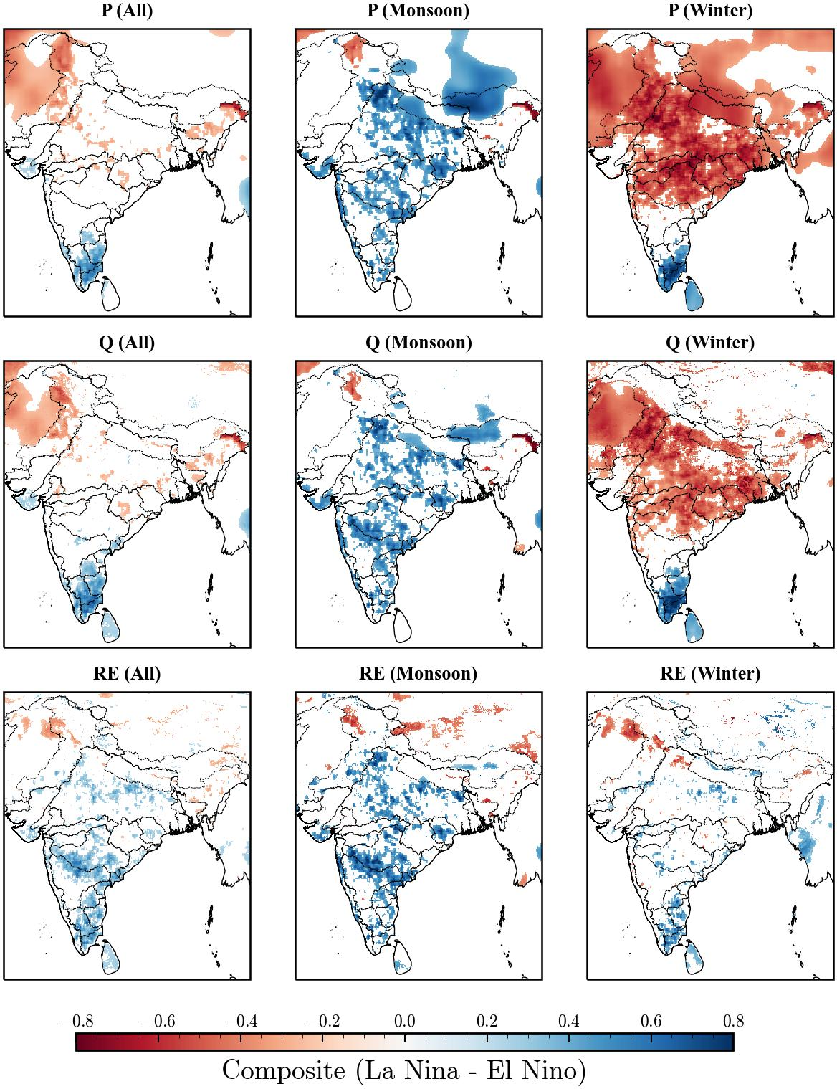
4_TELECONNECTION
Western disturbance
Monsoon

Slide 20
Physiographic aspect
USDA
LULC
Soil texture
Soil texture classification
Downloaded LULC ESRI from GEE
Download claycontent, silt content and sand content
Soil Structure
Soil Permeability
Reclassify the 10 classes into 6 classes
Created HSG soil groups

Slide 21
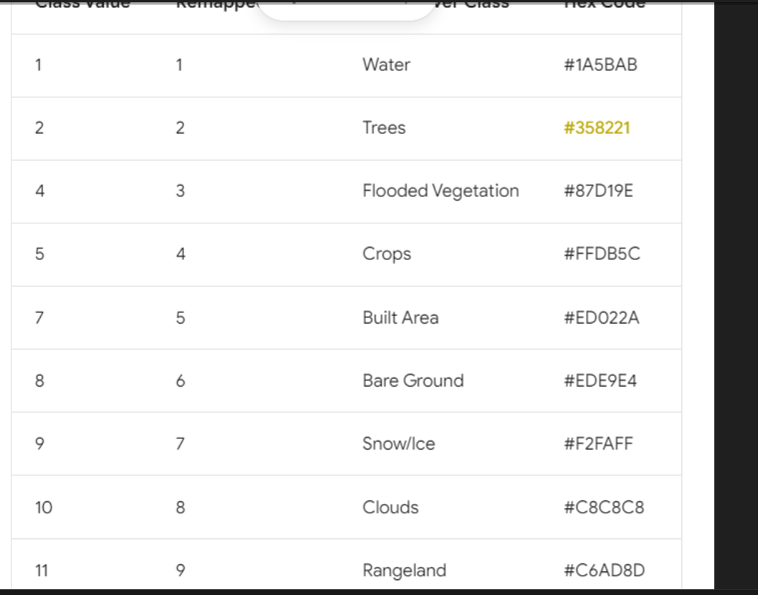
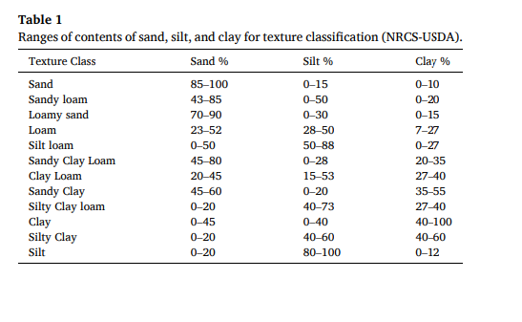
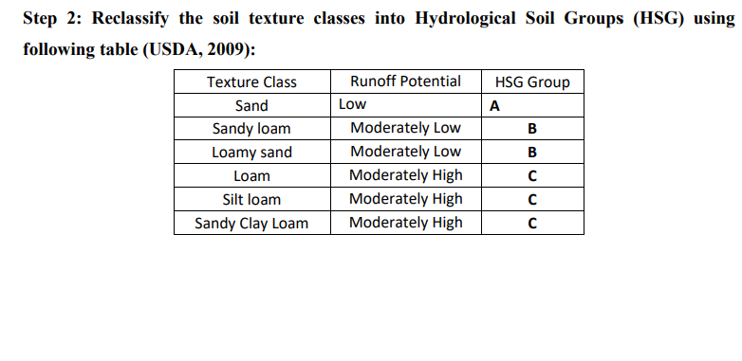
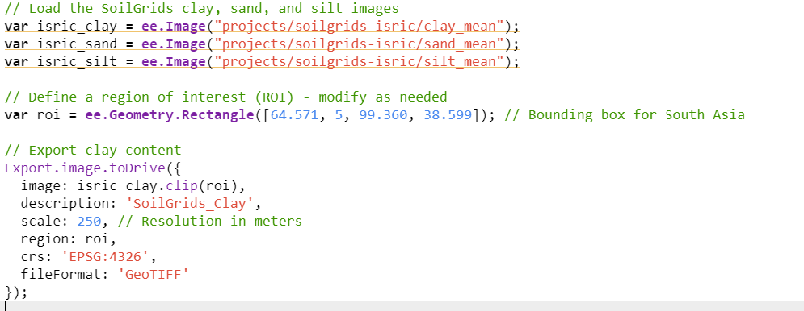
LULC

Slide 22
LULC
Source : https://gee-community-catalog.org/projects/isric/#citation

